Slide 1
Paraprofessionals-
training, appreciating, and retaining
Heather Kilburn-Lyons

Slide 2
Introductions

Slide 3
What do you hope to gain from today’s presentation?

Slide 4
Training Paraprofessionals

Slide 5
Getting to know your paraprofessionals
Ways to get to know them:
*Learn who they are away from school. Family, Hobbies and so on.
Professional Interest Survey
Personal Interest Inventory
Inquire what they did or are going to do on a weekend or break.
Back to school BBQ, Christmas Party & End of Year Celebration
  Families Included
  Personal time-no shop talk

Slide 6
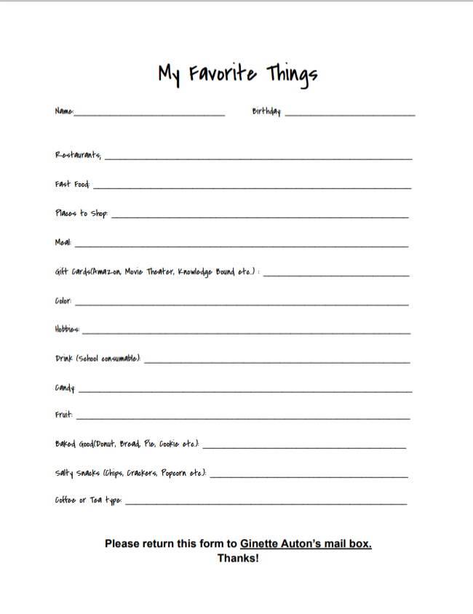
Getting to know your paraprofessionals

Slide 7
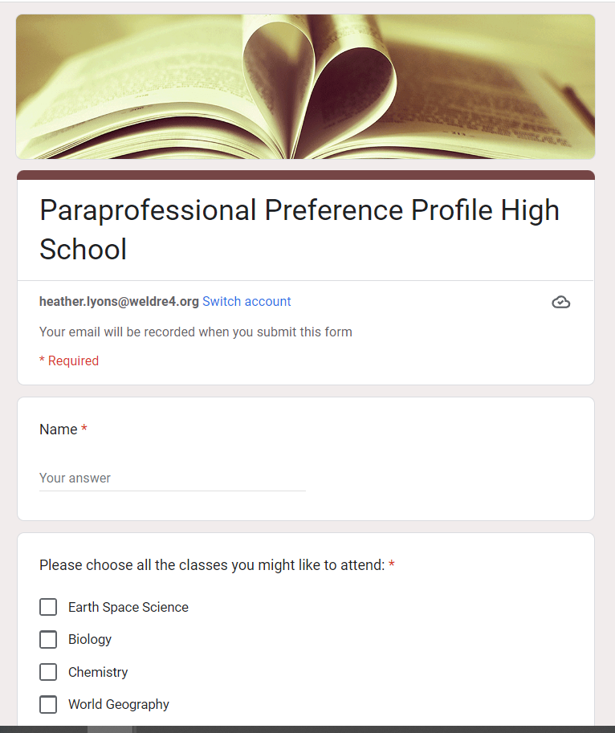
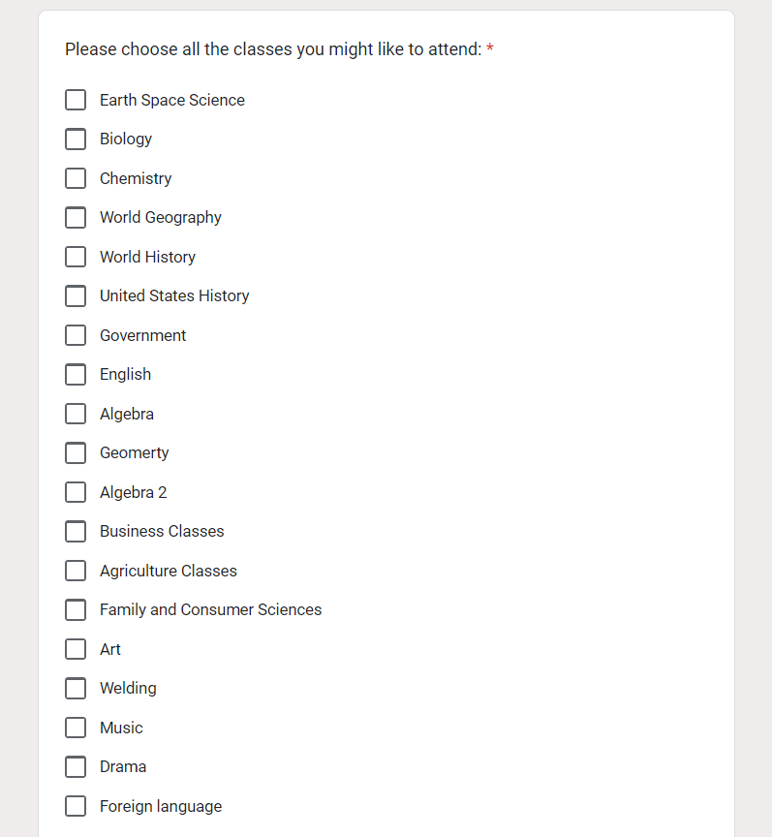
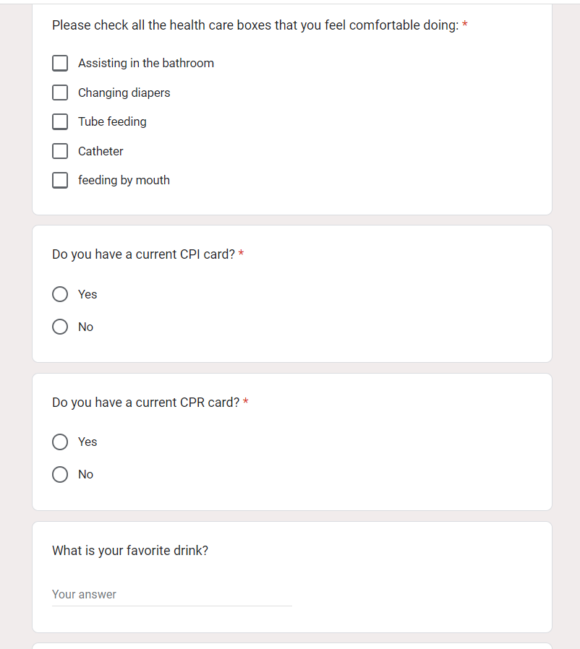
Getting to know your paraprofessionals

Slide 8
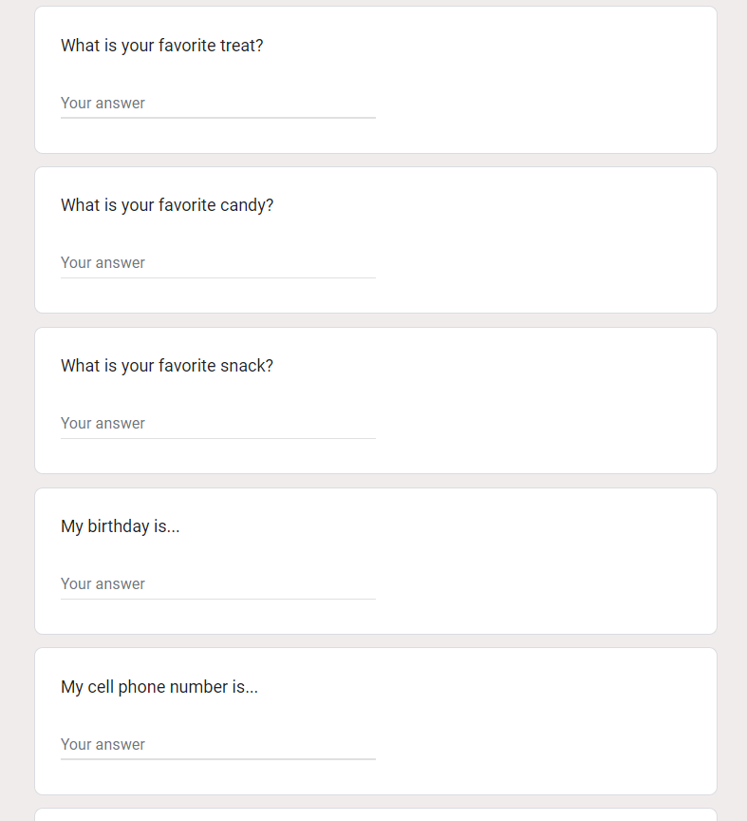
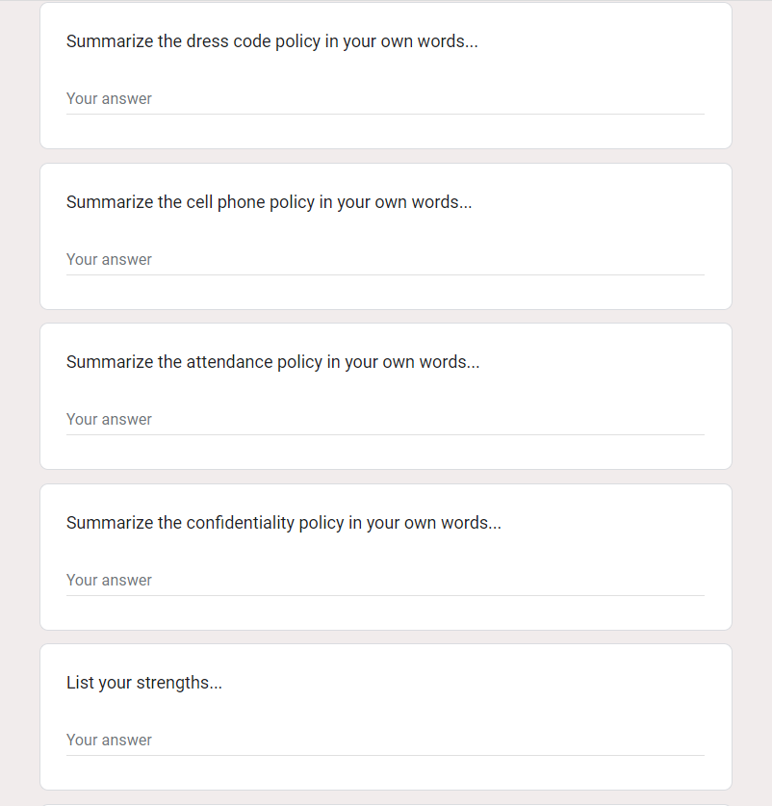
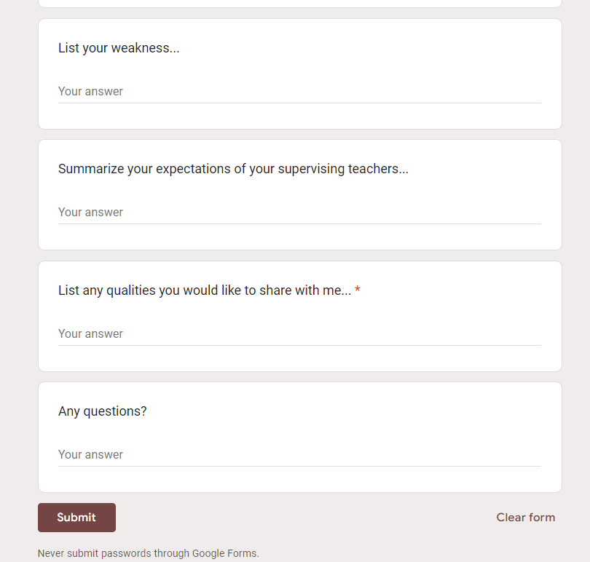
Getting to know your paraprofessionals

Slide 9
Paraprofessional Training
Paraprofessional Handbook
Welcome
Disability Areas
Roles and Responsibility
Instructing Students
Confidentiality
Expectations of the Job
Evaluating
Tips for Success
Para-Mentor
Trainings in programs or curriculum they are to be using or supporting
Behavior and health training and support

Slide 10
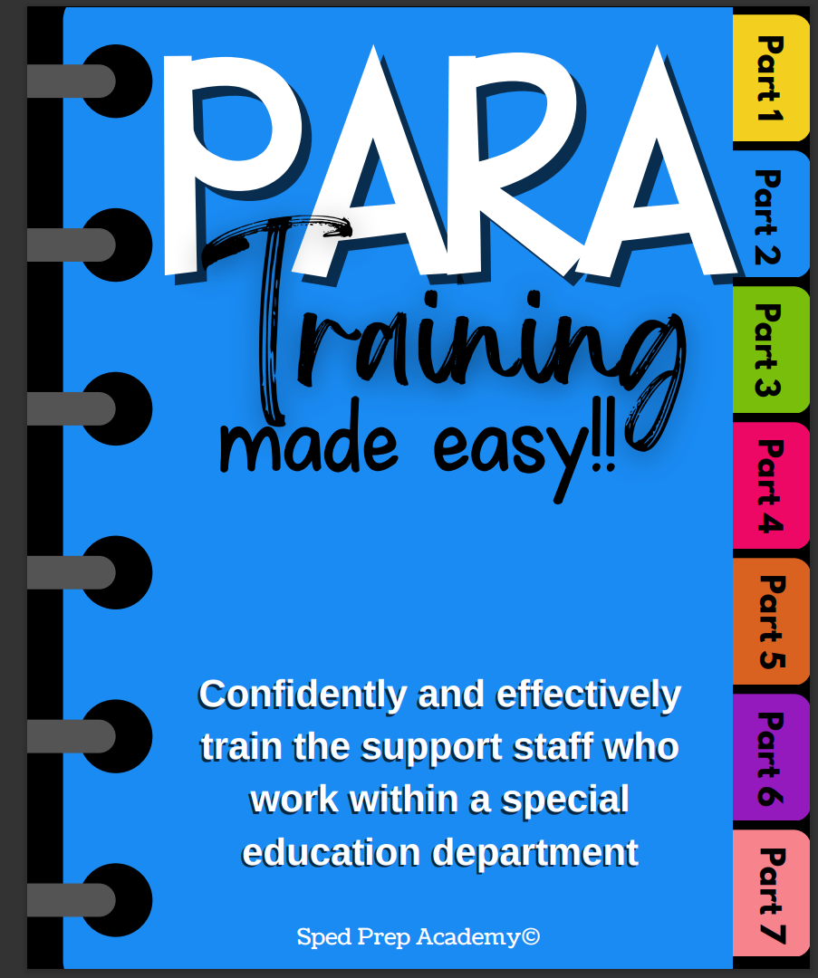
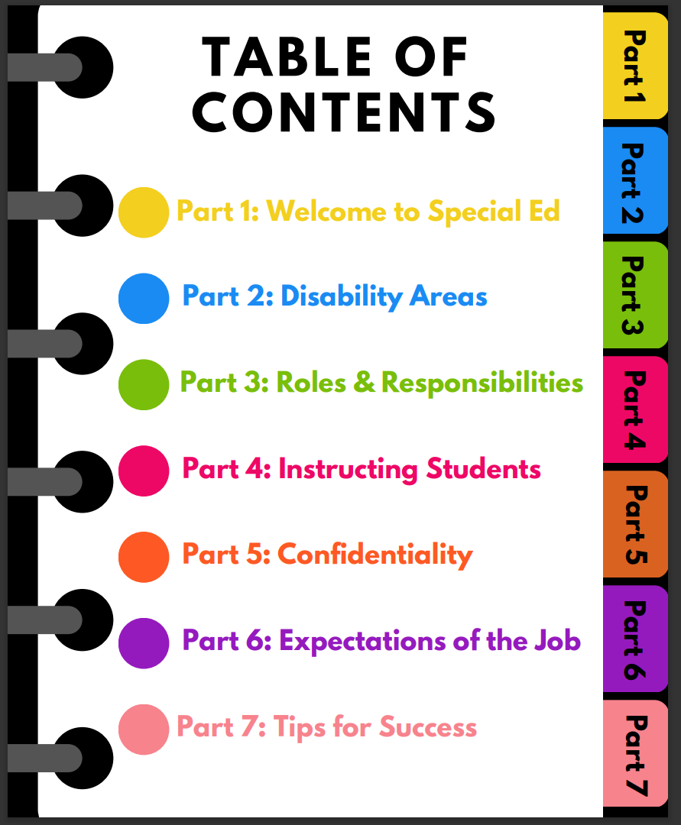
Paraprofessional Training

Slide 11
Appreciating Paraprofessionals

Slide 12
Ways to Appreciate
Bring In treats
Celebrate Birthdays & Special Days
  Even if it is over break or on a weekend, text, call or reachout somehow to let them know you are thinking about them.
Thank you notes, positive comments about a job well done!
Little gift cards for above and beyond.
Simple random acts of kindness.
Ensure they are getting paid for ‘time they donate’.
Laugh, cry and debrief together.

Slide 13
Ways to Appreciate
Advocate for them with administration, students and families.
Encourage students in thanking the Paraprofessionals for their help.
Ask their feedback and LISTEN to it!
Include them in decision making process when possible.
Check in with them to make sure if they need anything.
Do not ask them to do something you are not willing to do yourself.
Provide constructive feedback on how they are doing.
Honor them for the valued member of the team that they are!

Slide 14
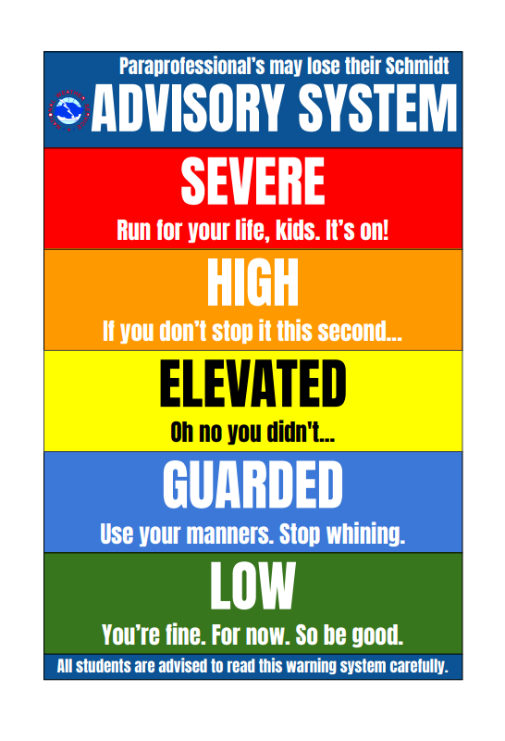
Ways to Appreciate

Slide 15
Retaining Paraprofessionals

Slide 16
Retain
Advocate for them with administration.
  Make sure they are taken care of for their time worked.
    Missed lunches, time volunteered, in early, stayed late.
      Paid, comp time, leave early or come in late to compensate.
      Don’t let them be the dumping ground for extra duties and responsibilities.
Advocate for them to be trained, just like teachers are.
  Ensure initial training on Special Education is done BEFORE they start.
  Offer trainings and room to grow in areas they find interesting or are struggling with.
  Train them on new students and or curriculum before they are expected to use it and not on after the fact.

Slide 17
Retain
Give honest, constructive feedback and be willing to take honest constructive criticism.
  Explain to them the ‘Why’ of things, not just expect them to do.
Continually search for ways to make sure they know how valuable they are and how important they are to you and your students.
Para specific Professional Development
Set them up for success, plan of day, expectations
Encourage Adult Brain Breaks

Slide 18
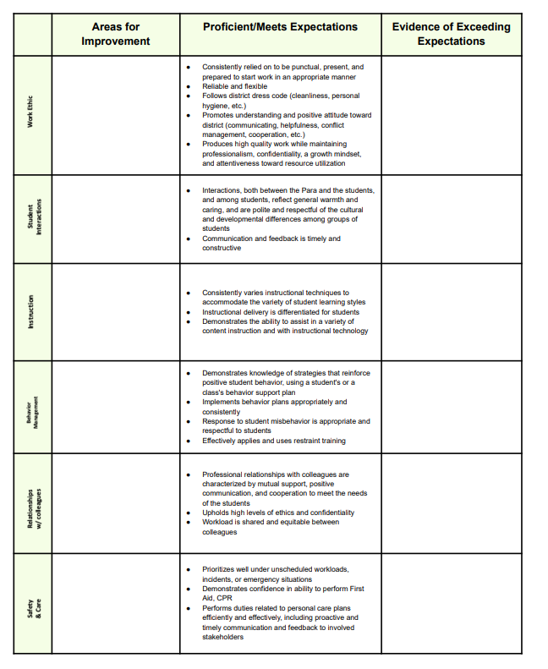
Retain

Slide 19
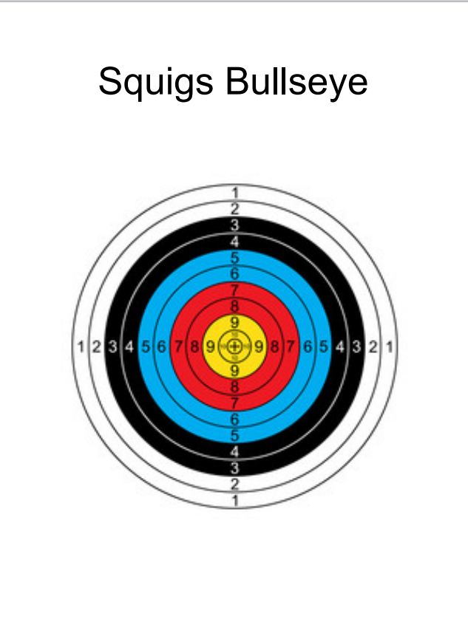
Retrain
Have Fun!
Celebrate!
Short Breaks!

Slide 20
Questions?

