Slide 1
Building Confidence: Managing Anxiety in Crucial
Conversations
Karan Steuart LCSW, LAC & Kristy Vance LCSW

Slide 2





Introductions

Slide 3
Welcome
Objectives for today’s session:
Understanding what makes a conversation “crucial”
Defining anxiety
Building skills to manage anxious feelings to better prepare for crucial conversations
Notes:
Karan

Slide 4
Agenda
Welcome and Objectives of the Session
Warm Up Activity
Brief Overview of Importance of Crucial Conversations
Building Confidence for Crucial Conversations and Strategies for Managing Anxiety
Practical Application: Role Playing Scenarios
Conclusion and Takeaways
Notes:
Karan

Slide 5
Warm Up Activity
Take a few minutes to reflect on a difficult conversation you have participated in
Notes:
Kristy

Slide 6
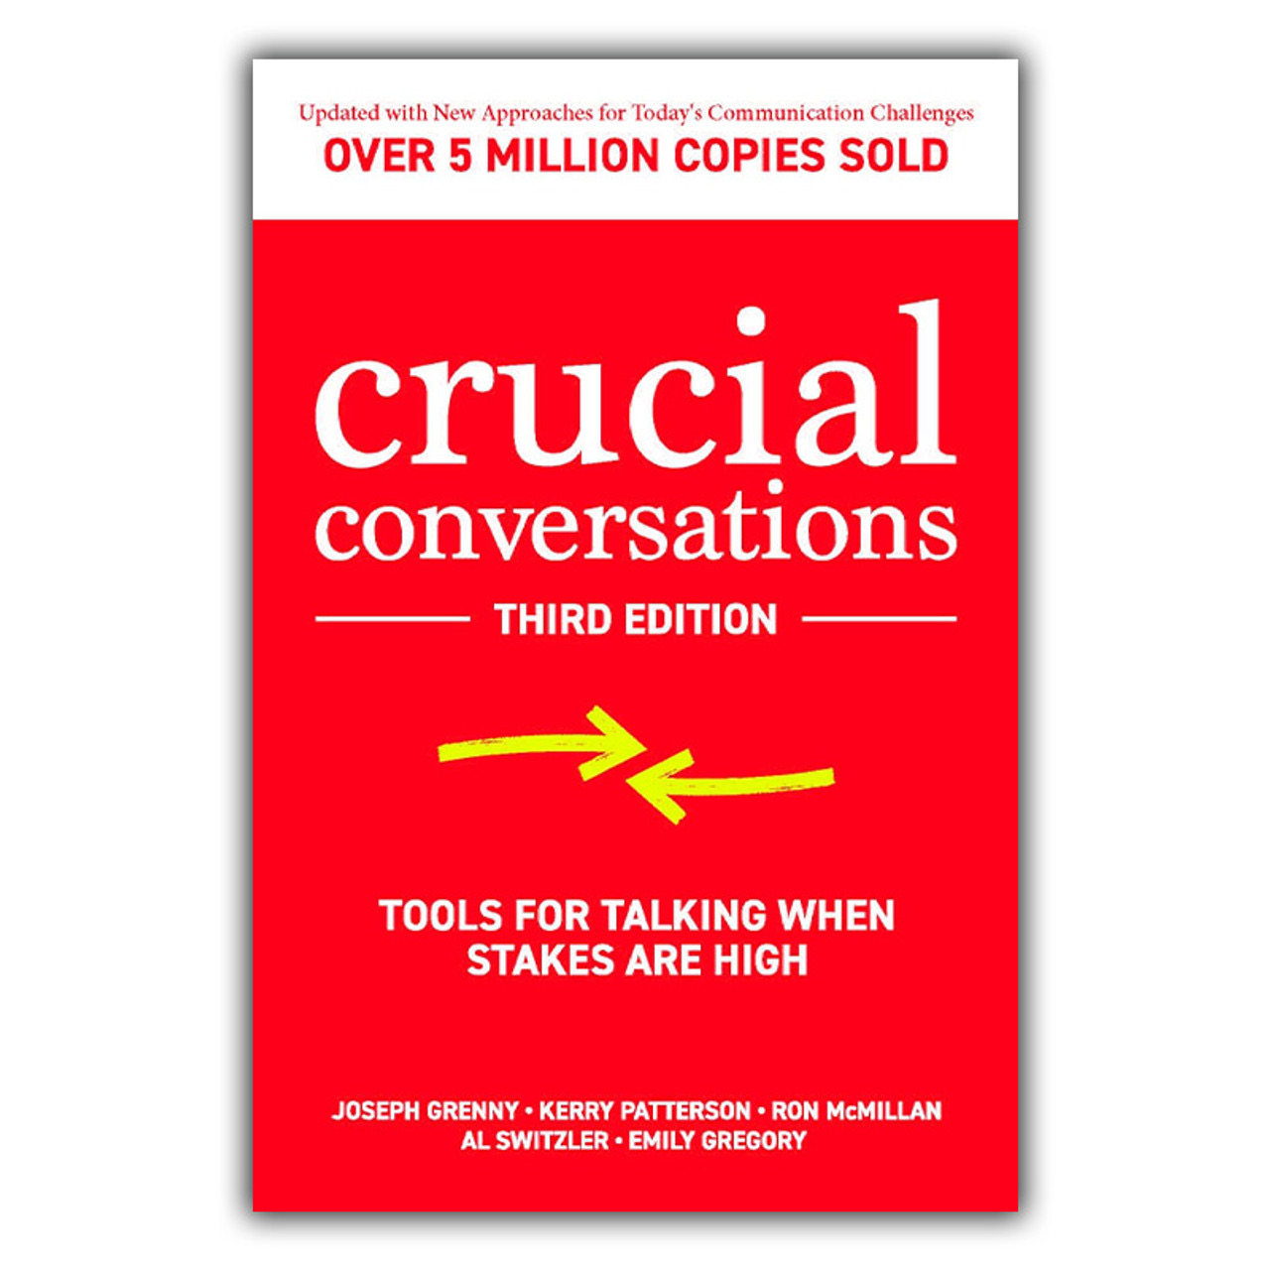
Brief Overview of Crucial Conversations
“The single biggest problem in communication is the illusion that it has taken place.”
― George Bernard Shaw
Notes:
Kristy

Slide 7
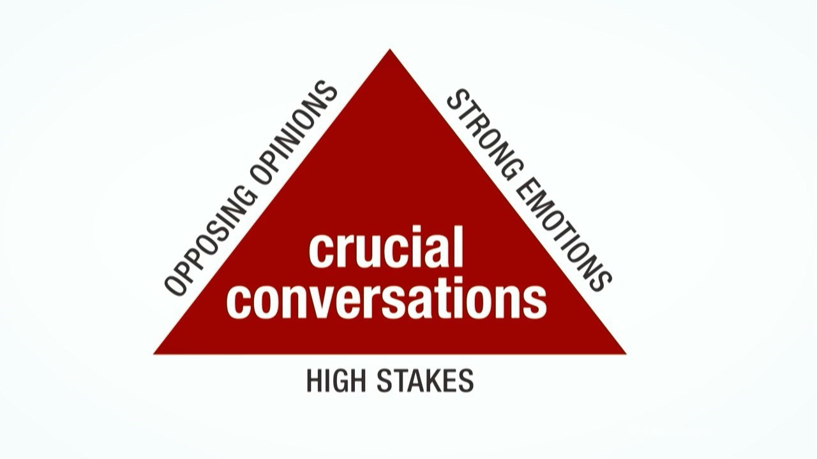
What is a crucial conversation?
A discussion between two or more people in which they hold (1) opposing opinions about a (2) high-stakes issue and where (3) emotions run strong.
Grenny, J., Patterson, K., McMillan, R., Switzler, A., & Gregory, E. (2021). Crucial conversations: Tools for talking when stakes are high (3rd ed.). McGraw-Hill Education.
Notes:
Kristy

Slide 8
Examples of crucial conversations in a school setting
Talking to a teammate who isn’t keeping commitments
Approaching a boss about their behavior
Critiquing a colleague’s work
Giving an unfavorable performance review
Informing parents of student behavior or progress at school
Creating an IEP/504/support plan for a student
Talking to a student about an academic or behavior concern
Grenny, J., Patterson, K., McMillan, R., Switzler, A., & Gregory, E. (2021). Crucial conversations: Tools for talking when stakes are high (3rd ed.). McGraw-Hill Education.
Notes:
Kristy

Slide 9
Communication Paradox
The irony is, the more crucial the conversation, the less likely we are to handle it well.
We avoid them- “Lag Time”
We handle them poorly - exaggerate, withdraw, yell
Notes:
Kristy

Slide 10
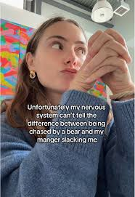
Reflection: Look back at the feelings you identified in the conversation from the start of the session - would this conversation be classified as ‘crucial’?
Notes:
Kristy

Slide 11
Building Confidence for Crucial Conversations
Practice anxiety management
Recognize when a conversation is “crucial”
Make it safe
Practicing assertive communication
Handling difficult responses with composure
Grenny, J., Patterson, K., McMillan, R., Switzler, A., & Gregory, E. (2021). Crucial conversations: Tools for talking when stakes are high (3rd ed.). McGraw-Hill Education.
Notes:
Karan

Slide 12
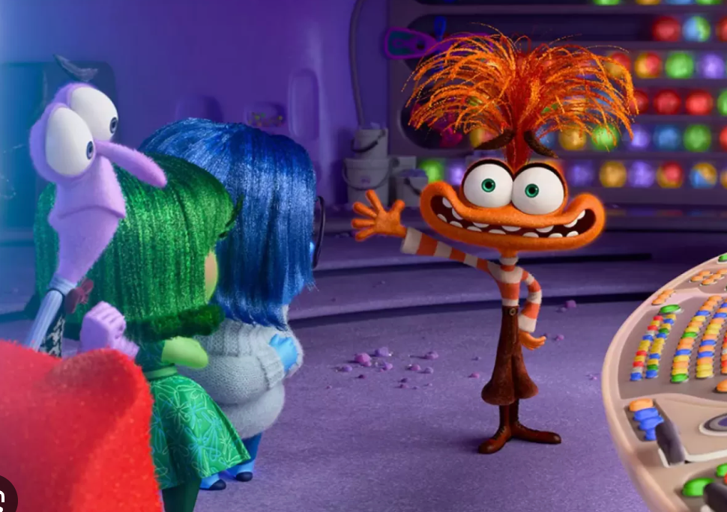
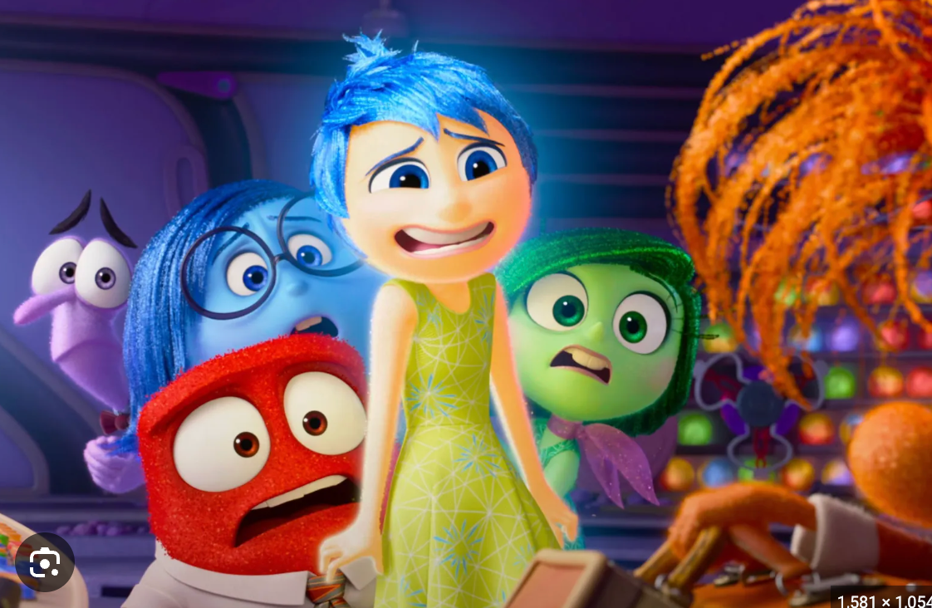

Slide 13
Anxiety: The Internal Alarm System
The most sophisticated tool for vigilance
Anxiety is essential for survival and safety and serves an important purpose. When managed well, it’s benefits include improved focus and performance; when unmanaged, it can interfere with engagement and understanding.
Normal or reasonable anxiety is intermittent, objective- associated with a specific concern, beneficial. Problem anxiety is irrational, chronic, interferes with daily life, subjective. During this presentation we will focus on managing experiences of beneficial, objective anxiety.
Ankrom, S. (2025, May 22)
Notes:
Karan

Slide 14
Understanding Anxiety in Crucial Conversations: Why, The Trigger, The Impact
Why Conversations Feel Anxious:
Perceived Risk: Fear of damaged relationships or career consequences.
Cognitive Load: Trying to manage your words, your tone, and the other person’s reaction simultaneously.
The Goal Shift: We move from "Solving the Problem" to "Surviving the Interaction."
Patterson, K., Grenny, J., McMillan, R., & Switzler, A. (2011)
Notes:
Karan

Slide 15
“Trigger” - the biological experience
The Trigger: High stakes + Opposing opinions + Strong emotions.
The Reaction: The Amygdala Hijack. Our brain perceives a threat to our ego or safety, triggering "Fight or Flight."
The Result: Blood flows away from the prefrontal cortex (the logical brain), making it physically harder to think clearly or stay calm.
"Impact" - the impact on communication
Internal Noise: Anxiety creates "mental clutter," making it difficult to listen or process what the other person is saying.
Safety Erosion: When we are anxious, we stop focusing on the goal and start focusing on protection.
Common Outlets: This anxiety usually manifests in two ways:
  Silence: Withdrawing, masking, or avoiding the truth.
  Violence: Controlling, labeling, or attacking to regain power.
Goleman, D. (1995); Patterson, K., Grenny, J., McMillan, R., & Switzler, A. (2011)

Slide 16
Exploring Anxiety
How can anxiety serve a purpose?
What are the benefits of anxiety?
Notes:
Karan

Slide 18
Finding Purpose within Anxiety
Moving from a pattern of avoiding and fleeing feelings associated with anxiety, identifying underlying purpose as signaled by these feelings essentially promotes a pivot from inaction to engagement. - Embracing the presence of anxiety as an indicator of something with deep value.
For instance, rather than retreating from the distress of social anxiety, recognizing the distress as a reflection of high purpose, such as a deep value for connection, allows one to step into meaningful action.
Ali (2025)
Notes:
Karan

Slide 19
Identifying Benefits of Anxiety in Crucial Conversation
Motivation: Anxiety can be helpful, It motivates us to prepare for challenges. Research shows anxiety drives action and helps us plan, practice, and prepare for difficult or high-stakes situations.
Preparation: Anxiety before an event can push you to prepare, plan for problems, and be more ready for difficult situations.
Attention: Anxiety helps focus attention on what matters, supporting preparation and success. Helps us to identify meaning.
Protection: Anxiety is a natural part of our nervous system that provides us with a sense to notice potential danger and to protect ourselves.
Communication: Finally, when people are anxious they are compelled to communicate and share these feelings. It is a way our body helps us find support and a safe place, and it can be effective in helping relationships work properly.
Meek (2021)
Notes:
Karan

Slide 20
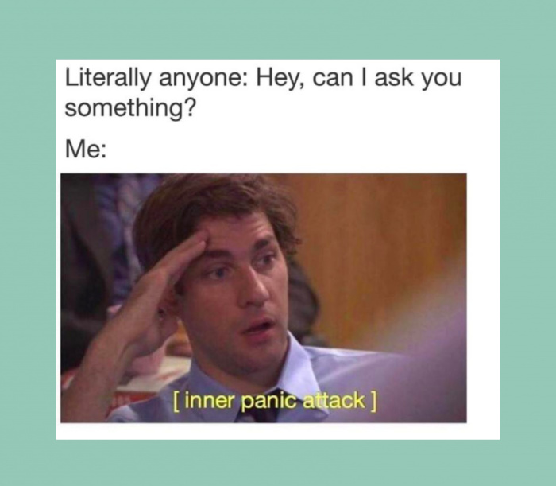
Strategies for Managing Anxiety
Notes:
Karan

Slide 21
So What Can We Do?
Reframing anxiety in high stakes crucial conversations from a place of fear and avoidance to one of strength and engagement, helps us move from a defensive mindset to an influential mindset. Anxiety in high stakes moments isn’t a sign of fear - it is a sign of engagement.

Slide 22
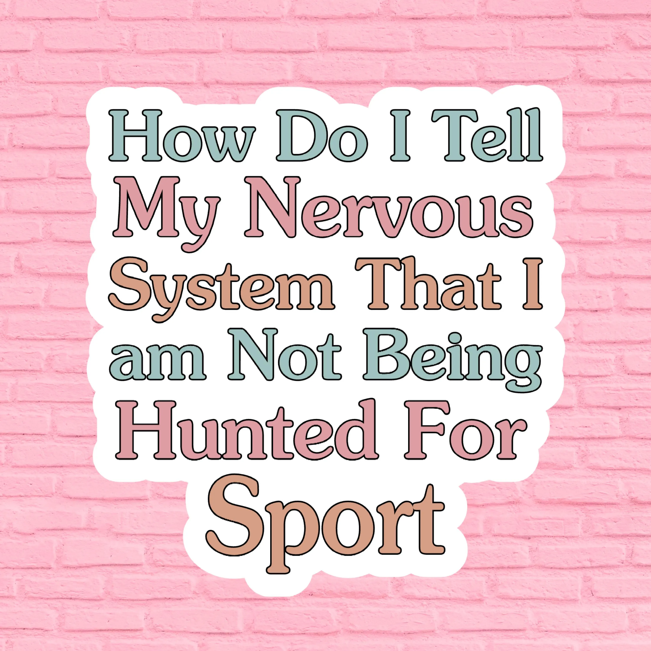
By definition, anxiety is experienced both psychologically and physiologically; it manifests as both cognitive thoughts and somatic sensations.
Anxiety is the anticipation of the possibility of what could or might happen.
In other words, it is present moment experience with future oriented worry.

Slide 23
Managing Anxiety – Specific to Crucial Conversations
Preparation: Outline your thoughts, goals and potential responses beforehand.
Start with heart: Define your positive intentions.
Manage your physiology: Slow your speech, take deep breaths, take short breaks, use calming mantras “I can participate in this”.
Start small: Practice assertiveness in lower stakes situations first.
Clarify Values: Connect the conversation to common values and shared meaning.

Slide 24
Deep Breathing
Focus on slow, deliberate breaths. Inhale for 4 counts, hold for 4, exhale for 6. This simple practice activates your parasympathetic nervous system, signaling to your body that it’s safe to relax.
Focus On What You Can Control
We become anxious after we tell ourselves the problem we’re experiencing is bigger than what we can handle. When this happens, focus on what part of the problem you have control over in the present moment and what choices you have. We always have reasonable choices available. Picking one starts the process of acceptance, which makes us feel more empowered and start having a better handle on the problem.
Mindful Observation
Choose an object nearby and study it with complete attention. Notice its colors, textures, shadows, and details. This focused attention “quiets” mental chatter.

Slide 25
2. Recognize when a conversation is “crucial”
Grenny, J., Patterson, K., McMillan, R., Switzler, A., & Gregory, E. (2021). Crucial conversations: Tools for talking when stakes are high (3rd ed.). McGraw-Hill Education.
Notes:
Karan

Slide 26


Slide 27
3. Make it safe
Human beings are wired to look for threats. Defensiveness is natural.
Intentionally establish care for the other person and their concerns.
Share your good intent.
  “My hope is that we can partner to ensure your student’s success”
Apologize when appropriate.
  “I apologize for the delay in replying to your email last week. Thank you for following up.”
Grenny, J., Patterson, K., McMillan, R., Switzler, A., & Gregory, E. (2021). Crucial conversations: Tools for talking when stakes are high (3rd ed.). McGraw-Hill Education.
Notes:
Karan

Slide 28
Contrast to fix misunderstandings
3. Make it safe
Don’t/Do statements to fix misunderstandings:
“Don’t” statement addresses concerns that you don’t respect them or have a malicious purpose.
“I don’t want to criticize your work. That wasn’t my intention”
“Do” statement clarifies your intentions. Confirms your respect and real purpose.
“I do want us to be able to communicate openly so we can address these concerns.”
Grenny, J., Patterson, K., McMillan, R., Switzler, A., & Gregory, E. (2021). Crucial conversations: Tools for talking when stakes are high (3rd ed.). McGraw-Hill Education.
Notes:
Karan

Slide 29
4. Practicing assertive communication
Share your facts
  Start with the least controversial and most persuasive elements.
Tell your side
  Explain what you are beginning to conclude
Ask for other’s views
  “How do you see it?” “What’s your perspective?” “Can you help me understand?”
Talk Tentatively
  “In my opinion..” “I believe…”
Encourage and model opposing views
  “Does anyone see it differently?” “What am I missing?” “I’d really like to hear the other side of this story”. “Maybe I’m wrong, what if the opposite is true?”
Grenny, J., Patterson, K., McMillan, R., Switzler, A., & Gregory, E. (2021). Crucial conversations: Tools for talking when stakes are high (3rd ed.). McGraw-Hill Education.
Notes:
Karan

Slide 30
5. Handling difficult responses with composure
Stay curious: “How did they arrive at this conclusion?”
Break the cycle: Don’t match the escalation
Practice active listening
Ask for their opinion- “Please let me know if you see it differently”
Describe what you see - “You’re saying it’s okay, but you sound upset”
Paraphrase what they say - “Let’s see if I understand. You’re concerned about…”
Grenny, J., Patterson, K., McMillan, R., Switzler, A., & Gregory, E. (2021). Crucial conversations: Tools for talking when stakes are high (3rd ed.). McGraw-Hill Education.
Notes:
Karan

Slide 31
When it feels like you’re getting nowhere…
Take your best guess at what’s going on.
“Are you thinking that we’re rushing into this decision and haven’t considered other options?
Notes:
Karan

Slide 32


Slide 33
Role Play Scenarios
Please find the group that has the same color paper as you
Notes:
Kristy

Slide 34
Engage in Crucial Conversation Practice
Read through the scenario
Identify “actors” and assign roles - all other group members can choose an actor to support in the preparation
How will you prepare mentally and emotionally for your role in the conversation?
How will you continue to maintain emotional regulation throughout the conversation?
Use the script provided to have the conversation and then reflect as a group about how each participant in the conversation might have been feeling before, during and after
Notes:
Kristy

Slide 35
Role Play Discussion
How did it go? What went well and what was challenging?
What strategies were effective during the planning stage?
What strategies were effective during the conversation?
Now, take a moment to reflect on your own journal prompt from earlier - how would you have approached that conversation differently with the tools and strategies you now know? Do you think the outcome of the conversation might have been different if you had these strategies then?
Notes:
Kristy

Slide 36
Conclusion & Takeaways

Slide 37
References
Ali, A. (2025, September 30). The shift from avoidance to connection in attachment styles: Understanding and healing avoidant attachment. Medium. https://medium.com/@ayazalipsychologist/the-shift-from-avoidance-to-connection-in-attachment-styles-0abfdfe40095
Gonçalves J, Lopes P, Esteves F, Fernández-Berrocal P. Must We Suffer to Succeed?: When Anxiety Boosts Motivation and Performance. Journal of Individual Differences. 2017;38:113-124. doi:10.1027/1614-0001/a000228
Herndon, J. (2021, August 9). Having anxiety versus feeling anxious what’s the difference? Healthline. https://www.healthline.com/health/anxiety/anxiety-vs-anxious
Marques, L. (2020, October 27). Do I have anxiety or worry: what’s the difference? Harvard Health online. https://www.health.harvard.edu/blog/do-i-have-anxiety-or-worry-whats-the-difference-2018072314303
Sherrell, Z. (2022, April 28). What to know about pathological anxiety. Medical News Today. https://www.medicalnewstoday.com/articles/pathological-anxiety-definition-causes-and-symptom
Meek, W. (2021, January 25). 5 ways anxiety can be helpful. Verywell Mind. https://www.verywellmind.com/top-ways-anxiety-is-helpful-1393079 Verywell Mind
Edmondson, A. C. (2018). The fearless organization: Creating psychological safety in the workplace for learning, innovation, and growth. Wiley.
Goleman, D. (1995). Emotional intelligence: Why it can matter more than IQ. Bantam Books.
Patterson, K., Grenny, J., McMillan, R., & Switzler, A. (2011). Crucial conversations: Tools for talking when stakes are high (2nd ed.). McGraw-Hill Education.
Ankrom, S. (2025, May 22). Nervous vs. anxious: What’s the difference? Verywell Mind. Verywell Mind is part of People Inc. — All rights reserved. https://www.verywellmind.com/is-it-normal-anxiety-or-an-anxiety-disorder-2584401

